Slide 1
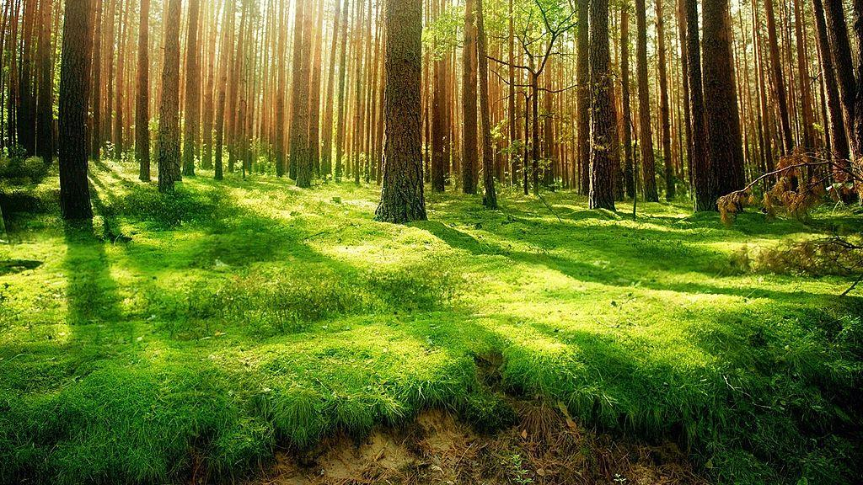
Slide 1 : Title slide
TITitle Tech -Based solution to combat environmental crisis
Subtitle : Tacking plastic, pollution , E-waste & deforestation through smart things.
Name -Bhawna Ahirwar(Solo)
College name-MIST indore,MP
Hackathon - Digigreen national hackathon 2025

Slide 2

Slide 2 - Problem statement
India is facing serious environmental degradation due to:
Plastic waste
E-waste accumulation
Rapid deforestation
Climate chage impacts (floods,droughts)
These affect public health , agriculture,and biodiversity

Slide 3

Slide 3 - Proposed solution (overview)
A smart monitoring and alert system using AI+IOT
Detects waste levels in regions+predicts danger zones(via ML)
Community -based recyling via app notifications
Gamified reward system for plastic /e-waste collection

Slide 4
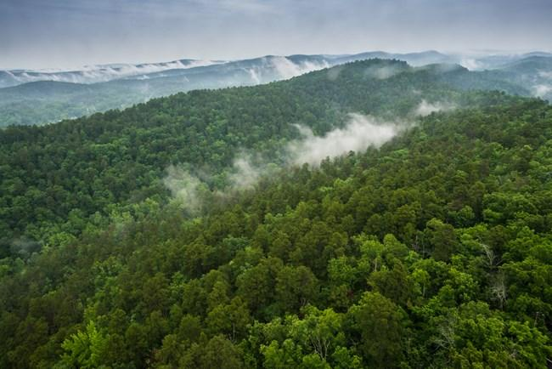
Slide 4 : Technologies Used
IoT sensors for waste detection and air quality monitoring
AL/ML models to predict high-pollution zones
Mobile app to connect community + awareness
Cloud Dashboard for real -time monitoring

Slide 5

Slide 5 : Expected impact
Reduce pollution & improve health
Encourage smart waste disposal
Empower youth and rural people with green-tech tools
Create jobs in recycling tech,app handling ,IoT maintenance

Slide 6

Slide 6 : Business/Execution Plan
Govt+NGO partnership for mass deployment
Students and local people trained via workshops
Revenue via recycling companies , green tech tie ups

Slide 7

Slide 7 : Conclusion
Environment + Technology = Future
With your support , we can protect Mother Nature sustainability
Let’s make India greener and cleaner

